Slide 1
David Dickinson
FIA Coordinator
Georgia Forestry Commission
PO Box 819
Macon, GA 31202
Forest Inventory and Analysis Program: Trends for Georgia’s Forest Land – 2016 FIA Data
Created by:
David Dickinson
FIA Coordinator for Georgia
ddickinson@gfc.state.ga.us
Using Evalidator Version 1.8.0.00 found at:
https://apps.fs.usda.gov/Evalidator/evalidator.jsp

Slide 2
Forest Inventory and Analysis, Georgia
FIA facts and history
The Forest Inventory and Analysis (FIA) Program is a cooperative program between the U.S. Forest Service and the states to provide estimates of the condition of the forest and forest trend data
A forest inventory was mandated as necessary by the U.S. Congress in the 1930’s in order to provide status updates of the United States’ forest resources
The data can:
Indicate if forest resources are being managed sustainably
Indicate trends such as gains or losses of forest acreage, the species composition of our forest, the age/quantity/quality of the timber resources and the health of our forests.
Data are collected on research plots across the state on public and private land
Landowners have the opportunity to deny access to their property at any time
David Dickinson
FIA Coordinator
Georgia Forestry Commission
PO Box 819
Macon, GA 31202

Slide 3
Forest Inventory and Analysis, Georgia
FIA in Georgia
Georgia assumed data collection responsibilities from U.S. Forest Service in 1998
All data are given back to the USFS for compilation/analysis
FIA is a 75% federally funded grant with 25% of funds matched by states with 5 year cycles
We currently have 12 foresters collecting FIA data across Georgia
All foresters on the FIA team in Georgia have degrees in forestry and are tested and certified prior to collecting data in order to maintain data integrity
All data, once compiled, is made available to the public at www.fia.fs.fed.us/tools-data and through publications such as Forest Factsheets and this powerpoint on the Georgia Forestry Commission website
No individual landowner information from the FIA Plots is made public in order to protect privacy

Slide 4
Forest Inventory and Analysis, Georgia
Why is a Forest Inventory Needed?
Without a forest inventory there is no scientific source for the trends of our forests – provides consistent metrics over time
Without a forest inventory, forestry decisions in our agency, the state government and the federal government are made based on feelings and popular opinion instead of numbers
Our numbers give forest industry the necessary information to decide to locate new wood using facilities here in Georgia – new mills = new jobs putting Georgians to work
FIA gives us the opportunity to correct undesirable forest trends before it is too late
FIA data are based on ground measurements and provide a ground truth for satellite imagery tools to test against and improve over time. Nothing replaces boots on the ground.

Slide 5
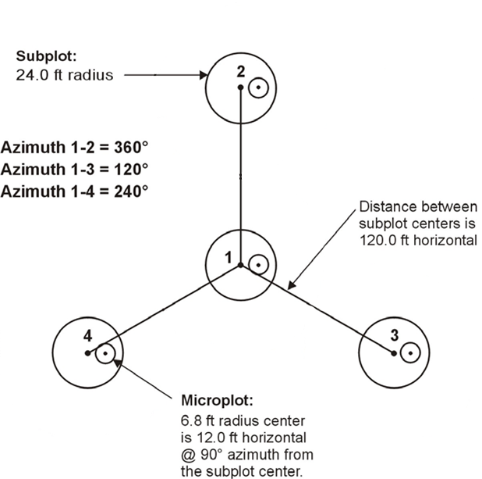
FIA Plot Layout
Each plot on which data are collected is made up of four 24’ radius subplots. Tree measurements are collected on trees 5 inches and greater within this radius. Information on smaller trees is collected within the microplot.
Notes:
This is the diagram of how one of our forest inventory plot is oriented in the woods.

Slide 6
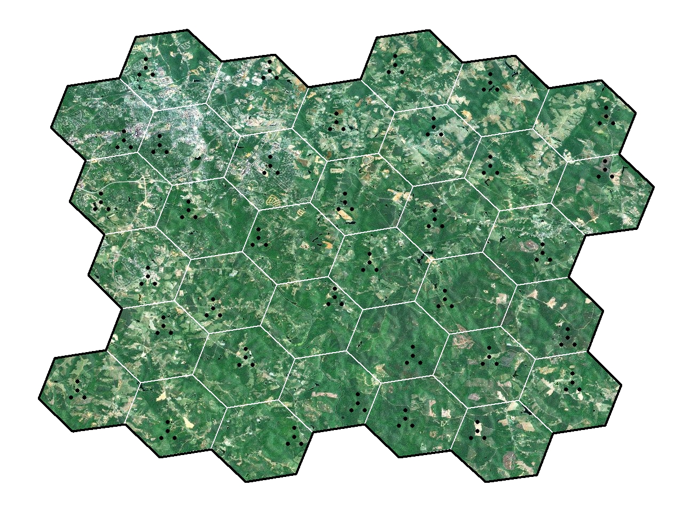
Hex Grid with One Plot per Hex (≈ 6,000 Acres)
One plot is placed randomly within each ~6000 acre hex. Each plot is permanent to allow for time 1 to time 2 comparisons of the same trees and any new ones. Each plot is remeasured about once every 5 years.
Notes:
This is to show how our plots are spread out across the state. The plot layout (each dot is a subplot) is enlarged so you can see it. In reality, at this scale the plot diagram would be too small to see since there is only 120’ between subplot centers. Each hexagon is approximately 6000 acres in size.

Slide 7
FIA Data Collected on Each Plot
Measurements include:
Species
Diameter
Height
Tree Class – is it straight enough?
Log Grade
Crown Position
Live Crown Ratio
Location of each tree from plot center using azimuth and distance
Invasive exotic plant species, slope, aspect, forest type, stand age, disturbances (fires, insects)/treatments (harvests, planting, natural regeneration)
Notes:
We do not collect information on endangered species. No individual landowner’s data is made available to the public.

Slide 8
Timberland Acreage Through Time in Georgia
Million Acres
Survey Year
Source: US Forest Service 2016 Data and The Georgia Forestry Commission
Notes:
Georgia’s timberland coverage has remained fairly stable since the 1950’s. Timberland losses in metro areas have been mostly compensated for by tree planting of non-forest (mostly idle farmland) land in the rest of the state. We have more timberland than we did in the 1930’s when FIA first began monitoring our forests.

Slide 9
Top Ten U.S. States in Total Timberland Acreage
Top Ten U.S. States in Total Timberland
Acres
Georgia’s Timberland Ownership
Georgia Timberland Ownership – 24.16 mil
Georgia is #1 in timberland acreage and privately owned timberland acreage in the U. S. While some western states have more forestland acreage, much of it is public land and unavailable for most forest products (reserved from harvest by law – such as Wilderness Areas).
Source: US Forest Service FIA Data 2016, 2017, 2018 (depending on state) and The Georgia Forestry Commission
Notes:
Most of the timberland in Georgia is owned by private individuals. Only 9% is owned publicly (for example: National and State Forests and Local Parks).

Slide 10
Timberland Acreage by Forest Type Group
Thousand Acres
Survey Year
Source: US Forest Service FIA Data 2016 and The Georgia Forestry Commission
Notes:
This graph shows the area in Georgia covered by each forest type group over time. You can see natural pine acreage was surpassed by planted pine acreage in the late 1990’s due to high reforestation rates after harvest. Pine plantation acreage has stabilized in recent years and is no longer increasing in Georgia due to reduced tree planting. The other forest type acreages have remained fairly stable with more hardwood acreage than we had in the 70’s.

Slide 11
Georgia Forest Land Acreage by Forest Type Group
Source: US Forest Service FIA Data 2016 and The Georgia Forestry Commission
Notes:
Georgia’s forests are a balance of pine and hardwood types with close to a 50-50 ratio.

Slide 12
Ownership Trend in Georgia, 1953 to 2014
Survey Year
Millions of Acres
Source: US Forest Service FIA Data 2016 and The Georgia Forestry Commission
Notes:
This graph shows the changes in acreage of forestland owned in each ownership class from 1953 – 2016. The majority of Georgia’s forestland is owned by private individuals. Forest industry purchased private forests in the 1950-70’s, and this trend reversed in the 1990’s through today as industry sold lands to private holders as well as corporate entities (such as Real Estate Investment Trusts or REIT’s, and Timber Investment Management Organizations or TIMO’s). Since these timber management corporate entities do no operate mills we do not classify them as forest industry.

Slide 13
Pine Timberland Acreage by Age Class and Survey Period
Millions of Acres
Age Classes
Source: US Forest Service FIA Data 2016 and The Georgia Forestry Commission
Notes:
This graph shows the age makeup of Georgia’s pine forests and how that has varied through the years. The spike in the 21-25 year age class was due to a lot of planting in the 80’s under the CRP program. Those trees are moving up through the age classes now, with a recent leveling out of the spike due to harvesting. Due to the decrease in such tree planting programs and wood market trends, we see a relatively small acreage covered by 1-5 year old pines. The lastest trend in 0-5 year old acreage is increasing, which will help Georgia remain sustainable. Plant now for a sustainable future for Georgia.

Slide 14
Planted Pine Acreage in the 0-5 Year Age Class by Survey Year
Acres
Survey Year
Source: US Forest Service FIA Data 2016 and The Georgia Forestry Commission
Notes:
The decline in young planted pine acreage, which is a result of decreased tree planting, could negatively affect Georgia’s sustainability in the future if not corrected. We are seeing some improvement in tree planting compared to 2009 and 2013 numbers. Plant now for the future!

Slide 15
Softwood Volume per Acre by Survey Year
71% Increase in Volume per Acre!
Cubic Feet Per Acre
Survey Year
Source: US Forest Service FIA Data 2016 and The Georgia Forestry Commission
Notes:
The wood volume per acre has increased through the years, which means we are growing more wood volume on the same acres through tree planting, tree improvement programs and better forest management. Better productivity per acre helps Georgia’s forests produce a sustainable supply of wood and allows us to protect/preserve sensitive areas. Since 1972, softwood volume per acre has increased 71% and continues to increase each year.

Slide 16
Volume of Softwood Trees by Diameter Class
and Survey Period
Million Cubic Feet
Diameter Class
Source: US Forest Service FIA Data 2016 and The Georgia Forestry Commission
Notes:
This graph shows how much of the softwood (mostly pine) volume is in each diameter class, with each line representing a survey period. Softwood volume continues to increase across all but the smaller diameter classes. Declines in the 6” diameter class is due to reduced tree planting in the last 15 – 20 years due to lower pulpwood prices.

Slide 17
Volume of Hardwood Trees by Diameter Class
and Survey Period
Survey Period
Billion Cubic Feet
Diameter Class
Source: US Forest Service FIA Data 2016 and The Georgia Forestry Commission
Notes:
This graph show hardwood volumes by diameter class with each line representing a survey period. Volumes continue to increase in the large diameter classes and there is currently more volume in all diameter classes of hardwood than in 1972.

Slide 18
Net Growth versus Removals on Timberland
For Softwood by Survey Period
Net Growth Exceeds Removals by 34%
Avg. Cubic Feet per year
Survey Period
Source: US Forest Service FIA Data 2016 and The Georgia Forestry Commission
Notes:
Net Growth = Total Growth of the trees minus natural mortality (from old age, insects, disease, weather, etc.). The Net Growth of softwood (mostly pines) has exceeded Removals (through harvesting) for the past 15+ years. As a result, Georgia’s softwood timber volume is the highest (see slide 21) since the forest inventory began in the 1930’s.

Slide 19
Net Growth versus Removals on Timberland
For Hardwood by Survey Period
Net Growth Exceeds Removals by 90%
Avg. Cubic Feet per year
Survey Period
Source: US Forest Service FIA Data 2016 and The Georgia Forestry Commission
Notes:
Net Growth = Total Growth of the trees minus natural mortality (from old age, insects, disease, weather, etc.). The Net Growth of hardwood has exceeded Removals since at least 1982. As a result, Georgia’s hardwood timber volume is the highest since the forest inventory began in the 1930’s.

Slide 20
Net Growth versus Removals for All Tree Species Combined
By Survey Period
Net Growth Exceeds Removals by 46%
Avg. Cubic Feet per year
Survey Period
Source: US Forest Service FIA Data 2016 and The Georgia Forestry Commission
Notes:
This graph shows net growth versus removals for all species combined. Georgia has been growing more wood volume than we are harvesting since the 1990’s, which continues to add to our already high timber volumes.

Slide 21
Volume by Forest Type Group and Survey Period
Billion Cubic Feet
Survey Period
Source: US Forest Service FIA Data 2016 and The Georgia Forestry Commission
Notes:
This graph shows volumes for the different Major Forest Type Groups through the years. Volumes have increased across all major forest type groups when comparing 2016 to previous years.

Slide 22
Georgia’s Forests…Final Thoughts
Our forests are being managed sustainably
Forests benefit all Georgians with a continuous flow of goods and services of traditional forest products
Also benefits society with clean air, clean water, wildlife habitat, soil conservation, recreation and aesthetic benefits
Remember that 2 out of 3 raindrops in Georgia fall on forestland
Planting pines now for the future is what Georgia needs to remain sustainable
www.gatrees.org
Notes:
As the previous information has shown, our forests are being managed sustainably and provide many benefits for every Georgian. Our forests provide traditional forest products to sustain our wood using industries, but also cleanse the air and water, provide habitat for wildlife, stabilize and conserve our soil, provide recreational opportunities, and provide aesthetic benefits across our diverse landscapes, which in turns improves our quality of life.
And remember, 2 out of every 3 raindrops fall on a forest in our state, and some of this is delivered to a faucet near you.

